Slide 1
Internet Marketing
Nok Nahm # 11
Anna # 13
Fah # 22

Slide 2
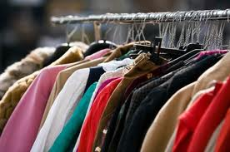
What we sell…
We sell second-handed clothes and we choose social media to promote our products.

Slide 3
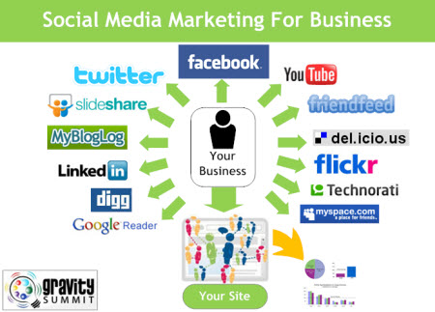
Social media marketing
One of the most popular ways to sell products is to sell through social media. Facebook is an example. There are millions of users. The primitive strategy is that people will share our second-handed clothes page. It will be known for many visual friends. Moreover, there’s no cost for the page.

Slide 4
Referral marketing
Almost like social media marketing strategy. A person can tell about our products to many of his friends. We will reward to the that person, as a guarantee that our shop is a reliable shop.

Slide 5
Web analytics
We will study the customers’ behavior when visiting our website. We can see how many people visit our website a day or when do people visit our website the most or even what is the country they come from. We can use those information as our strategy to sell our second-handed clothes.

Slide 6
Revenue sharing
We will have someone make a banner of his products on our website. This way we can earn more money by gain the commission. There might be second-handed shoes or bags because they relate to our products.

Slide 7
Content marketing
We will make creative content about our products by using different methods. We can make videos, as an advertising or may be a short movie. We might also make a blog about using second-handed clothes to persuade the readers about how is it good to wear second-handed clothes.

Slide 8
